Slide 1

AI and Machine Learning : Multi Dimensional Perspectives
Dr Srinivas Padmanabhuni
CTO
Tarah Technologies http://www.tarahtech.com http://tarah.ai
Contact: srinivas@tarahtech.com

Slide 2
Data Science Life Cycle and Types of Analytics

Slide 3
Data Science Life Cycle

Slide 4
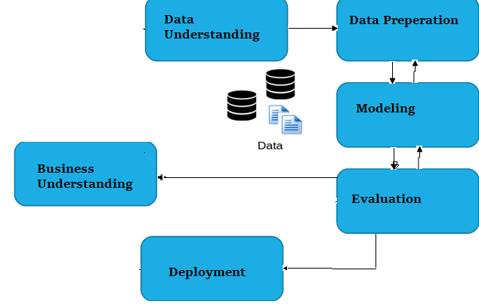
Data Science Life Cycle – CRISP DM Method
CRISP-DM Model(Cross Industry Standard Process for Data Mining)
This model was conceived in late 1996
The first two steps of CRISP-DM model are used by Data Scientists to gain knowledge and work with data
Different steps are as below:
Business Understanding
Data Understanding
Data Preparation
Modeling
Evaluation
Deployment
Source: http://www.sv-europe.com/crisp-dm-methodology/
Notes:
4

Slide 5
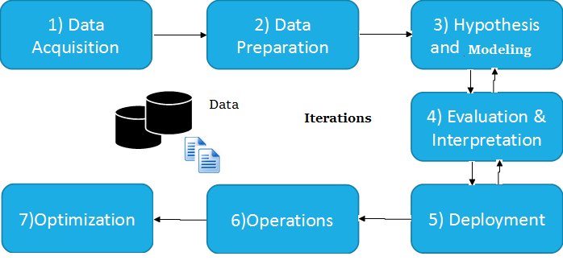
Data Science Life Cycle – CRISP DM Method
The typical Data Science Life Cycle Model have following steps
Data acquisition
Data Understanding
Data Preparation
Hypothesis and modeling
Evaluation and Interpretation
Deployment
Notes:
5

Slide 6
Data Science Life Cycle – CRISP DM Method
Data acquisition-
Data acquisition includes collecting information from both inward and outer sources, including online networking or web scratching or an excel sheet that is already collected.
Data Extraction schedules are setup. This schedules are followed by a set of built in procedures, once the system is stable and in operation and is required for rebuilding the model
Example: Reading a csv file in python
data=pd.read_csv('oj.csv')
Notes:
6

Slide 7
Data Science Life Cycle – CRISP DM Method
Data preparation-
Usually referred to as "information wrangling“.
This steps involves cleaning the data and reshaping it in the required format.
It may also involve creating a new attribute as a combination of two or more dependent attributes to fasten the process.
It may involve imputation – replacing null values
Eample: data elimination, data imputation
i=df.fillna(df.mean(), inplace=True)
Notes:
7

Slide 8
Data Science Life Cycle – CRISP DM Method
Hypothesis and modeling are the traditional data mining steps
Model choice and algorithm choice for the target model to be deployed finally
This includes splitting the dataset into train and test data sets for creating the models and cross-validating the results. Also for gauging the mode whether supervised or unsupervised learning
The process till now will be repeated multiple number of times with different algorithms until we get a high accuracy
Once reasonable accuracy is obtained the corresponding algorithm and model is baselined for deployment
Notes:
8

Slide 9
Data Science Life Cycle – CRISP DM Method
Deployment
Deployment is performed in a pre-creation or "restricted"/"pilot" environment before the genuine full-scale deployment
Operations
This operations stage would help in ensuring DevOps for deployment of the learned model for predictive analytics
It can trigger regeneration of model if due to concept drift model execution degrades beyond a certain acceptable threshold
Notes:
9

Slide 10
Data Science Life Cycle – CRISP DM Method
Optimization
The last stage in the Data Science Life Cycle
In terms of optimization the deployed model is checked for accuracy after deployment and observed for concept drift or drastic decrease in accuracy levels
Once we find a drastic accumulation of new data after deployment of the model, it is another cause for recalibration of the model
So model may need retraining and regeneration
Notes:
10

Slide 11
Types of Analytics

Slide 12
Five Kinds of Analytics
Descriptive
Inferential
Exploratory
Predictive
Prescriptive

Slide 13
Descriptive Analytics
First level analysis of data
Typically has measures of central tendency
  Mean
  Median
  Mode
Additionally has measures of dispersion
  Variance
  Standard Deviation
For any data descriptive analytics provides the first level understanding of data
  Univariate and Bivariate are two sorts of measurable sets of metrics
  Ex: The Average marks secured by 100 students in a cluster. The other measures like sum, median, mean etc. are used in Descriptive Data Analysis to understand the properties of Data

Slide 14
Code for Descriptive Analytics

Slide 15
Inferential Analytics
Usually need not work with entire input population
Inferential Data Analysis is used to estimate the properties of the data based on the summary of properties of Data obtained in Descriptive Data Analysis.
Can work with a smaller sample to get statistical idea
Sometimes sampling needs to get an idea of the overall distribution of the data
Inferential Analytics can be used to estimate parameters and test statistical hypothesis
In a scenario, where we do not have access to the complete population, but only a limited number of data, we use Inferential Data Analysis.

Slide 16
Exploratory Data Analysis
Discovering patterns and associations in the data via external examination without serious mining
Typically used to find similar data or clusters of data
Also used to find associations between different data items
  Exploratory examinations are normally not the authoritative response to the analytics needed but give a rough idea
  Example is Market Segmentation which is a type of Exploratory Data Analysis

Slide 17
Predictive Analytics
The different sorts of techniques that investigate present and past data to make predictions about future occasions
Several Machine Learning Models are investigated for applicability
Sometimes the problem is classification sometimes it is regression
Via an extensive exploration of different algorithms a final deployable model is generated with high accuracy

Slide 18
Prescriptive Analytics
Often just generating a model or pattern for a data is not enough
We need action to follow up after predictive or exploratory steps
Prescriptive Analytics works on the notion of an action step
Several potential actions can be identified but prefer the optimal action
Cost Benefit analysis of different actions examined before making the actual choice of action

Slide 19
Modelling in AI / Data Science Problems
Patterns of data – extracted from data (Descriptive, Exploratory)
Anomaly Detection – Outliers and Unusual Behavior detection (Descriptive, Inferential, Predictive)
Correlations between multiple data sets (Exploratory, Inferential)
Suggesting recommendations for overcoming faults (Prescriptive)
Clusters in sets of data (Inferential, Exploratory)
Extrapolation to a future value (Predictive)
Classify (Predictive)
Optimize (Prescriptive)

Slide 20
Code for Inferential Analytics

Slide 21
Probability and Naive Bayes

Slide 22
Conditional Probability

Slide 23
Bayes’ Theorem
A = Wet Garden
B1 = It Rained. B2 = It did not Rain.
P(B1) = 0.4 (Apriori) , P(B2) = 1 – 0.4 = 0.6
P(A|B1) = 0.9, P (A|B2) = 0.2
By Bayes Theorem : P (B1 | A) = (0.9 * 0.4)/ ((0.9*0.4)+(0.2*0.6))=0.36/(0.36+0.12)=0.75

Slide 24
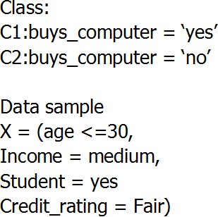
An example
P(Ci): P(buys_computer = “yes”) = 9/14 = 0.643
P(buys_computer = “no”) = 5/14= 0.357
Compute P(X|C_{i}) for each class
P(age = “<=30” | buys_computer = “yes”) = 2/9 = 0.222
P(age = “<= 30” | buys_computer = “no”) = 3/5 = 0.6
P(income = “medium” | buys_computer = “yes”) = 4/9 = 0.444
P(income = “medium” | buys_computer = “no”) = 2/5 = 0.4
P(student = “yes” | buys_computer = “yes) = 6/9 = 0.667
P(student = “yes” | buys_computer = “no”) = 1/5 = 0.2
P(credit_rating = “fair” | buys_computer = “yes”) = 6/9 = 0.667
P(credit_rating = “fair” | buys_computer = “no”) = 2/5 = 0.4
X = (age <= 30 , income = medium, student = yes, credit_rating = fair)
P(X|C_{i}) :
P(X|buys_computer = “yes”) = 0.222 x 0.444 x 0.667 x 0.667 = 0.044
P(X|buys_computer = “no”) = 0.6 x 0.4 x 0.2 x 0.4 = 0.019
P(X|C_{i})*P(C_{i}) : P(X|buys_computer = “yes”) * P(buys_computer = “yes”) = 0.028
P(X|buys_computer = “no”) * P(buys_computer = “no”) = 0.007
Therefore, X belongs to class (“buys_computer = yes”)

Slide 25
Naïve Bayes
Bayes Theorem
Naïve Independence Assumption

Slide 26

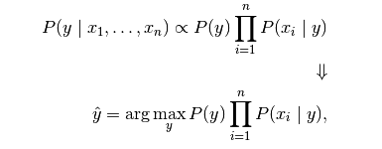
Revised Bayes theorem and Naive Bayes Classifier
Bayes Theorem Simplifies to
Outcome of the classification

Slide 27


Types
Gaussian
Multinomial
Bernoulli

Slide 28
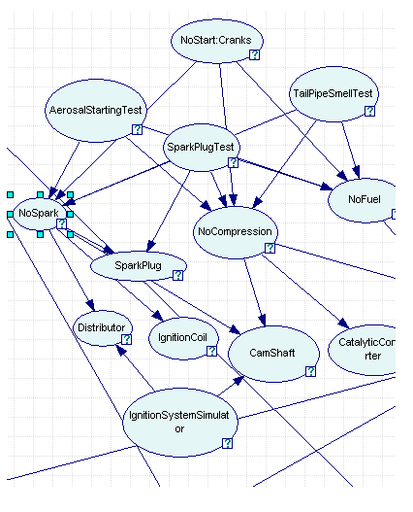
Example Bayesian Network

